Slide 1

Feature Engineering
By Himanshu Shukla
(Data Scientist)

Slide 2
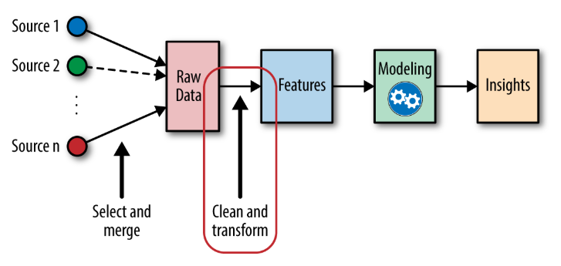
Ye hai Kya?
Feature engineering is a machine learning technique that leverages data to create new variables that aren't in the training set. It can produce new features for both supervised and unsupervised learning, with the goal of simplifying and speeding up data transformations while also enhancing model accuracy.

Slide 3

HELLO!
I am Himanshu Shukla
I am here because I love Data Scientist.
You can find me at himanshu.shukla.him@gmail.com

Slide 4
Final clean data for machine
1. Feature Transformation, 2. Feature Construction, 3. Feature Selection, 4. Feature Extraction
1.
2.
3.
4.
Feature Engineering
For model

Slide 5
1. Feature Transformation
Feature Transformation
Missing value Imputation
Outlier Detection
Feature Scaling
Handling Categorical Features

Slide 6
2. Feature Construction
Data Driven
Hypothesis Driven
Knowledge based and Hybrid
Various Approach to construct new features
Feature construction is a process that discovers missing information about the relationships between features and augments the space of features by inferring or creating additional features
The data-driven approach is to construct new features based on analysis of the available data by applying various operators. The hypothesis-driven approach is to construct new features based on the hypotheses generated previously. The knowledge-based is to construct new features applying existing knowledge and domain knowledge.

Slide 7
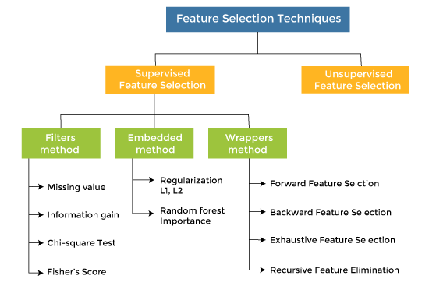
3. Feature Selection
Feature selection is a process that chooses a subset of M features from the original set of N features (M <= N), so that the feature space is optimally reduced according to a certain criterion.

Slide 8
4. Feature Extraction
PCA
LDA
A FEEDFORWARD NEURAL NETWORKS Approach
ICA
LLE
T-SNE
AE
Feature extraction is about extracting/deriving information from the original features set to create a new features subspace. The primary idea behind feature extraction is to compress the data with the goal of maintaining most of the relevant information. As with feature selection techniques, these techniques are also used for reducing the number of features from the original features set to reduce model complexity, model overfitting, enhance model computation efficiency and reduce generalization error.

Slide 9
THANKS!
Any questions?
You can find me at:
Himanshu.shukla.him@gmail.com

